Slide 1
Shape, Space, and Landscapes

Slide 2
Shape
Shape - A 2-dimensional area that has defined edges, and has a height and width but no depth.
One of the Elements of Art

Slide 3
Geometric Vs. Organic
Geometric Shape – Precise shape with uniform sides, often found in man-made objects.
Organic Shape – Shape or form found in nature. Free form.

Slide 4
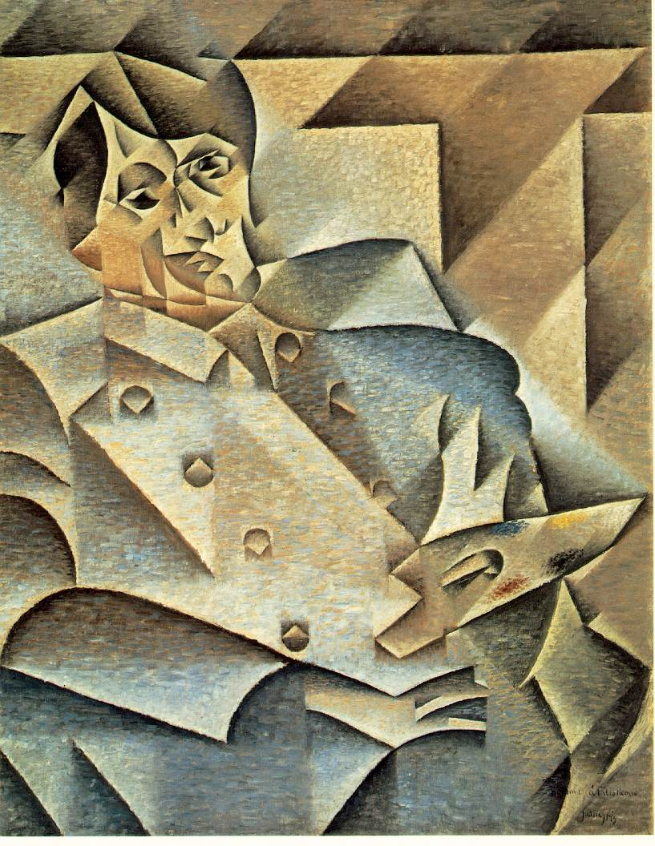
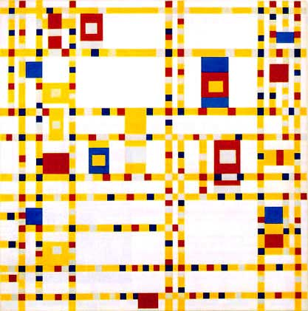
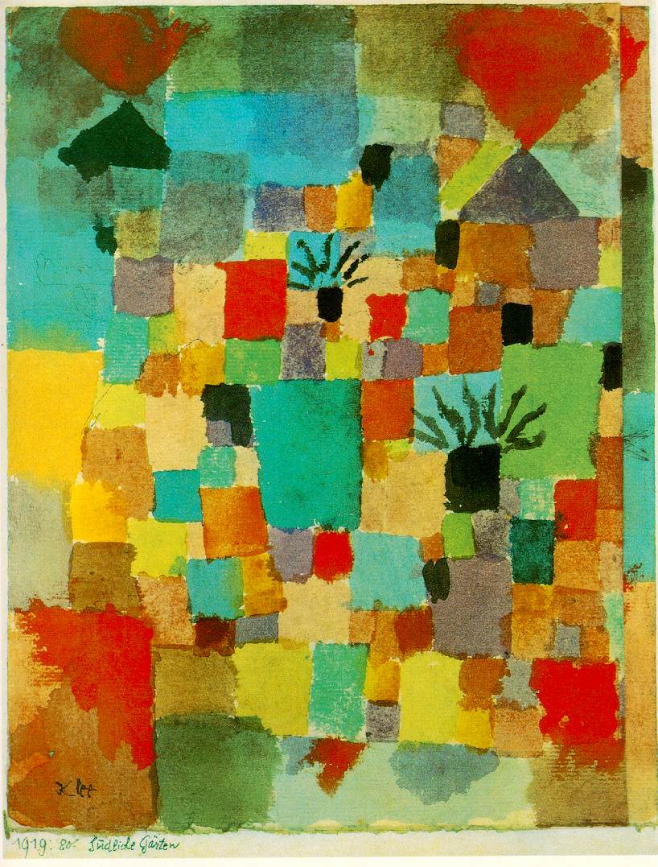
Broadway Boogie Woogie by Piet Mondrian
Portrait of Picasso by Juan Gris
Tunisian Gardens by Paul Klee

Slide 5
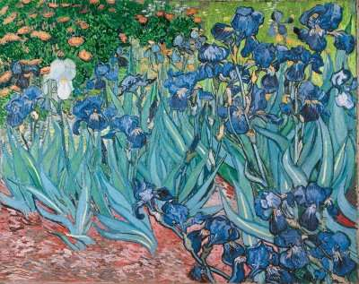
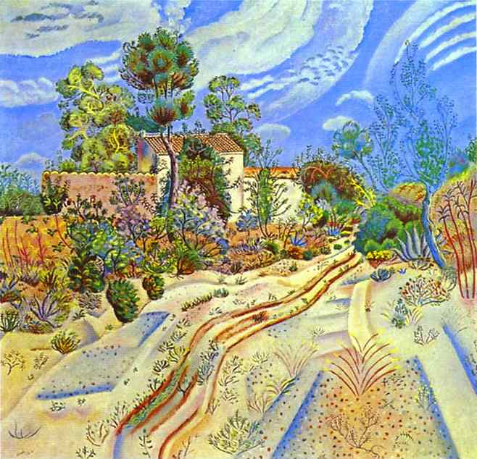
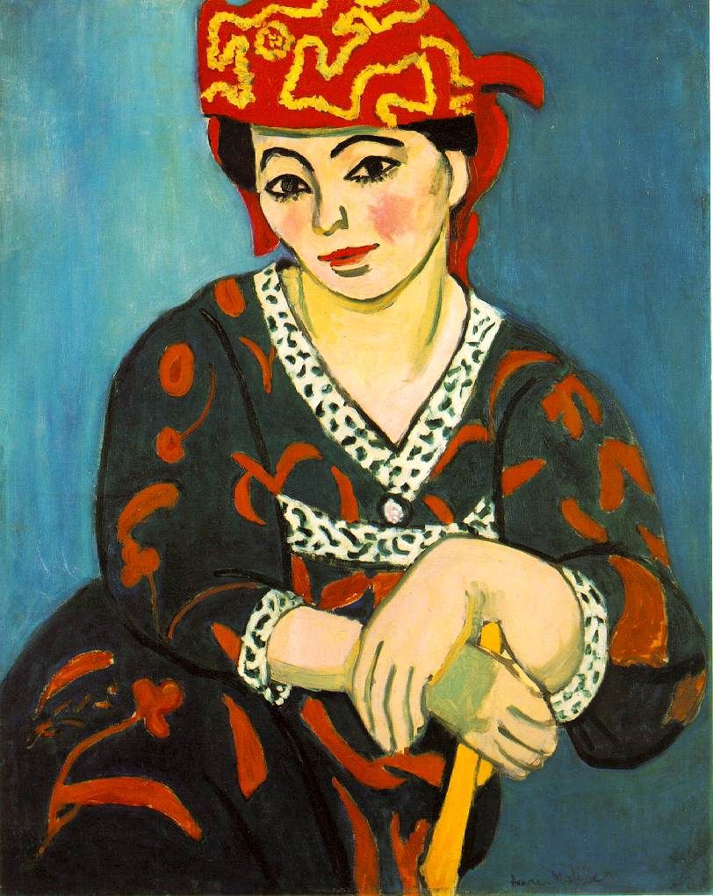
Irises by Vincent Van Gogh
Wagon Tracks by Joan Miro
Portrait of Madame Matisse by Henri Matisse

Slide 6
Space
Space – the area in or around an object
One of the Elements of Art
Positive Space – the object
Negative Space – the area around the object

Slide 7
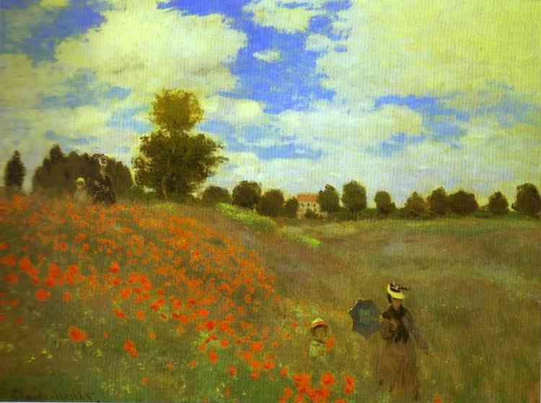
Landscapes
Landscape – an outdoor scene viewed from a distance

Slide 8
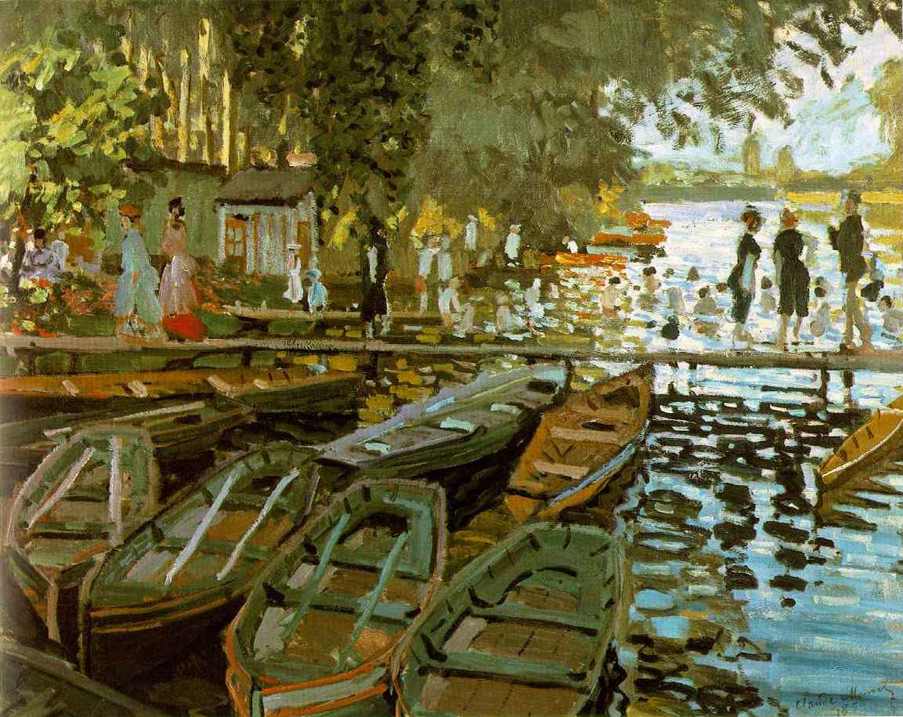
Landscapes
Foreground – the area the looks closet to the viewer. Largest objects.

Slide 9
Landscapes
Middle Ground – the area between the foreground and the background

Slide 10
Landscapes
Background – the area that looks farthest from the viewer. Near the horizon line. Smallest objects.

Slide 11
Landscapes
The foreground, middle ground, and background work together to create a sense of space on a two-dimensional surface.

