Slide 1
Color

Slide 2
Primary Colors
red
yellow
blue
The primary colors make up all the other colors.
Primary colors cannot be made by mixing colors together

Slide 3
Secondary Colors
orange
green
violet
(purple)
The secondary colors are made by mixing two primary colors together.

Slide 4
Tertiary Colors
red-orange yellow-orange yellow-green
blue-green blue-violet violet-red
The tertiary colors are made by mixing a primary and a secondary color together.

Slide 5
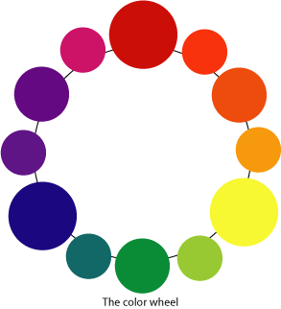
Color Wheel

Slide 6
Three Properties of Color
Hue
Value
Intensity

Slide 7
Hue
Hue - The name of a color in the color spectrum
What hue is this square?
What hue is this circle?
What hue are these triangles?

Slide 8
Value
Tint = hue + white
Shade = hue + black
tints
shades

Slide 9
Tint or Shade?
1.
2.
3.
4.
5.
6.

Slide 10
Intensity
Intensity - The brightness or dullness of a hue
bright
dull

Slide 11
Complementary Colors
Complementary colors are directly across from each other on the color wheel.

