Slide 2
Color

Slide 3
Primary color

Slide 4
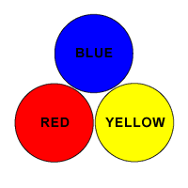
Primary color
A group of colors from which all other colors can be obtained by mixing.

Slide 5
Secondary color

Slide 6
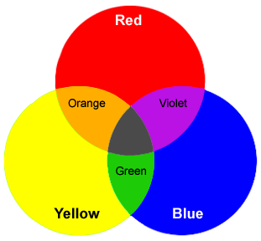
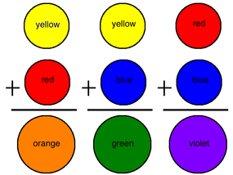
Secondary color
a color resulting from the mixing of two primary colors.

Slide 7
Tertiary colors

Slide 8
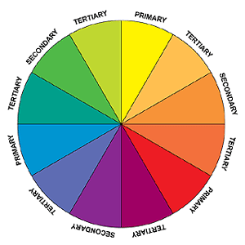
Tertiary colors
Tertiary colors are combinations of primary and secondary colors.
There are six tertiary colors:
red-orange
yellow-orange
yellow-green
blue-green
blue-violet
red-violet.

Slide 9
Tint

Slide 10
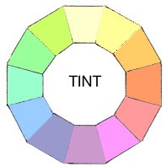
Tint
The mixture of a color with white, which increases lightness
Red + white=pink

Slide 11
Shade

Slide 12
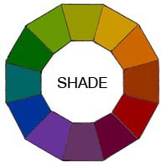
Shade
The mixture of a color with black, which reduces lightness

Slide 13
Tint or Shade
1.
2.
3.
4.
5.
6.

Slide 14
Tone

Slide 15
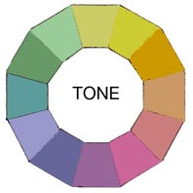
Tone
The mixture of a color with gray, or by both tinting and shading

Slide 16
Complimentary colors

Slide 17
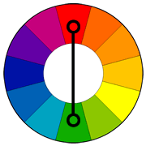
Complimentary colors
Colors opposite each other on the color wheel
When placed next to each other, they create the strongest contrast for those particular two colors.
When combined, cancel each other out. This means that when they are combined, they produce a brown or grey-scale color

Slide 18
Analogous colors

Slide 19
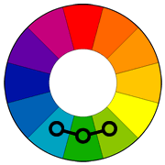
Analogous colors
Groups of three colors that are next to each other on the color wheel
One color is the dominant color, which tends to be a primary or secondary color, and one on either side of the color.
Red, red-orange, and red-violet are examples

Slide 20
Warm colors

Slide 21
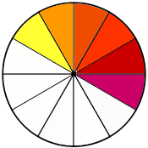
Warm colors
The yellows, oranges, and reds of the color spectrum, associated with fire, heat, sun, and warmer temperatures

Slide 22
Cool colors

Slide 23
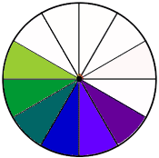
Cool colors
The greens, blues, and purples of the color spectrum, associated with water, sky, ice, and cooler temperatures

Slide 24
Monochromatic

Slide 25
Monochromatic
All the colors (tints, tones, and shades) of a single hue.

