Slide 1
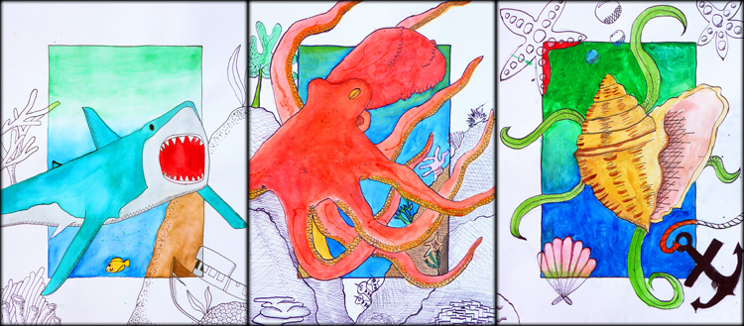
Beyond the Border

Slide 2
Watercolor Technique
Glazing
Wash
Gradient (dark to light)
Color Gradient
Straw
Wet-on-Wet
Salt/Isopropyl
Controlled Splatter

Slide 3
Watercolor Technique
Write the following vocabulary in your sketchbook.
GLAZE­ A new color is painted on top of dry paint.
WASH A large area is painted with an even tone of one color
GRADIENT Color fades evenly from dark to light.
COLOR GRADIENT­ Fades evenly from one color to another.
STRAW­ Paint is spread by blowing through a straw.
WET-­IN-­WET­ A new color is added on top of wet paint.
SALT­ Salt is sprinkled on wet paint to create a speckled effect.
ISOPROPYL­ Drops are added to wet paint to create light spots.
SPLATTER (CONTROLLED)­ Paint is strategically splattered.

Slide 4
Practice with Round Brush
Practicing with the round brush will help you to achieve lines and shapes with clean, crisp edges. By applying different amounts of pressure to the bristles, you can create thick or thin lines with the same brush. Round brushes are especially good for making foliage (plant leaves). After completing the following exercises, you will become more familiar with ways of manipulating the round brush to create different effects. We will use plain 8 ½ by 11” paper for our practice.
Please perform the following exercises in order. Pay careful attention to the directions and make sure you complete the activity in its entirety.
You may choose any color except yellow for your practice exercises.
Make 10 long lines that transition from thick to thin. Put 10 lines per sheet of paper. Each line should be made parallel across the paper and should be at least 8 inches long. When you first start your line, press firmly as you drag the bristles across the paper to create a thick line. When you’ve nearly reached the center of the paper, gradually decrease the pressure to transition to a thin line.
Make 10 long lines that transition from thin to thick. Put 10 lines per sheet of paper. Each line should be made long ways across the paper and should be at least 8 inches long. When you first start your line, press lightly as you drag the bristles across the paper to create a thin line. When you’ve nearly reached the center of the paper, gradually increase the pressure to transition to a thick line.
Make 10 curvy lines. Put 5 lines with a large degree of curve and 5 lines with a small degree of curve on the same piece of paper. Your lines may overlap. Use your wrist to make the curvy motions rather than trying to draw as you would with a pencil.
Make 10 overlapping circles of different sizes. Put 10 circles per sheet of paper. A couple circles should fit the paper widthwise and should decrease in size down to about 1-inch diameter. Again, use your wrist to make the circular motions rather than trying to draw as you would with a pencil.
Make one page with 5 leaves as demonstrated in class. Use a flicking motion to create each leaf, pressing harder near the base of the leaf and flicking outward to the tip. After the 5 leaves have dried, use1 leaf to demonstrate texture with each of the following techniques: contour outline, hatching, cross-hatching, stippling and random mark.
You should now have 5 pages. Place them in the order above with your name written at the bottom of the top sheet. Staple the 5 pages together with a staple in the top left corner. Each page is worth 20 points for a total of 100 points and will be graded on accuracy. This assignment is a QUIZ grade.

Slide 5
Rule-of-Thirds
The Rule of Thirds is more of a guideline than a rule.
It is intended to help the artist with the placement of the elements and focal point within the composition.

Slide 6
Rule-of-Thirds
Here is how the Rule of Thirds works:
Draw two equally-space vertical lines
Draw two equally-spaced horizontal lines
It looks like a tic-tac-toe board
This divides your rectangle or square canvas into nine equal parts
This creates four points where the lines intersect or ‘hot-spots’ or ‘sweet-spots’
Studies show that placing objects in these intersections creates a pleasing composition
Balance in the design can often be achieved by placing a secondary object or counterpoint at the opposing intersection.
This creates more interest, tension and energy rather than just centering the subject
Applying the rule of thirds to a painting keeps your composition from being split in half either vertically or horizontally
Avoids the main focus from the center of the painting like a bull’s-eye.

Slide 7
Research
Use Google images to look for sea life, that you might be interested in using for this project.
Consider what other objects might be included in your composition.
Shark
Humpback whale
Killer whale
Dolphin
Seahorse
Octopus
Squid
Sea turtle
Starfish
Eel
Jellyfish
Lion fish
Clown fish
Barracuda
Puffer fish
Polar bear
Penguin
Albatross
Seashell
Seaweed
Coral

Slide 8
Composition Criteria
Include a centered 9x12 rectangle frame.
Include a focal point that depicts sea life.
Include a scene around your focal point.
Incorporate focal point using rule-of-thirds.
Extend the main subject “Beyond the Border” on all 4 sides of the frame.

Slide 9
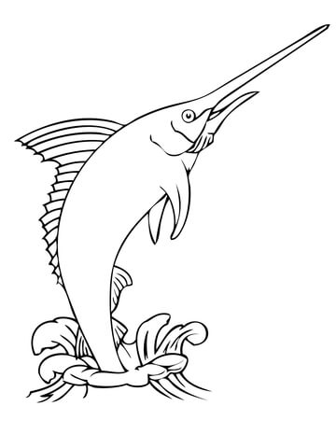
Composition Sketch
Once you have established the content of your artwork, create a drawing in your sketchbook.
Include a 4x6 inch rectangle in the center of your drawing so that your sea life can extend beyond the border.
Allow your drawings to overlap and extend off of the page.

Slide 10
Composition Final
Once you have a complete drawing in your sketchbook, transfer the drawing to watercolor paper.
You will receive 1 piece of watercolor paper.
Include a 9x12 inch rectangle in the center of your drawing so that your sea life can extend beyond the border.
Be sure to enlarge your drawing.

Slide 11
Composition Questions
Answer the following questions on your rubric.
1. The focal point of my subject is the __________________________.
2. Using the Rule-­Of-Thirds technique, I placed the focal point in the (circle one) area of the rectangle.
top left top right bottom left bottom right
3. The main subject extends “Beyond the Border” on ______ sides of the frame.

Slide 12
Composition Rubric

Slide 13
Watercolor
Use 6 or more of the watercolor techniques practiced in class.
Glazing
Wash
Gradient (dark to light)
Color Gradient
Straw
Wet-on-Wet
Salt/Isopropyl
Controlled Splatter

Slide 14
Watercolor
Always wait for a section of color to dry before adding another wet color next to it.
Colors that bleed cannot be erased!

Slide 15
Watercolor Questions
Answer the following questions on your rubric.
GLAZE­ A new color is painted on top of dry paint. ________________________________________
WASH­ A large area is painted with an even tone of one color. _______________________________
GRADIENT (DARK TO LIGHT)­ Color fades evenly from dark to light____________________________
COLOR GRADIENT­ Fades evenly from one color to another. _________________________________
STRAW­ Paint is spread by blowing through a straw________________________________________
WET-­IN-­WET­ A new color is added on top of wet paint. ____________________________________
SALT­ Salt is sprinkled on wet paint to create a speckled effect _______________________________
ISOPROPYL­ Drops are added to wet paint to create light spots. ______________________________
SPLATTER (CONTROLLED)­ Paint is strategically splattered. __________________________________
Circle one: My watercolor techniques demonstrate skill or need more work.

Slide 16
Watercolor Rubric

Slide 17
Texture
Use a ____ pen.
Apply cross hatching on the border and over watercolor to create value and texture.
Apply stippling on the border and over watercolor to create value and texture.

Slide 18
Texture Questions
Answer the following questions on your rubric.
Circle True or False:
1. I used cross hatching on my border and over my watercolor to
create shadow. T F
2. I used stippling on my border and over my watercolor to create
shadow. T F
3. My pen-work demonstrates EXPERT skill and control. T F

Slide 19
Texture Rubric

