Slide 1
Welcome To
Back To School Night 2018
E. Mehalko
esmehalko@henrico.k12.va.us
Artebeaux.weebly.com

Slide 2
Welcome Message
Hello, my name is Liz Mehalko and you can reach me at esmehalko@Henrico.k12.va.us
I began teaching middle school art in North Carolina in 2005. This is my 5th school year at Highland Springs High School.
I currently teach Digital Media & Design I, Art II and Art III.

Slide 3
Grading Expectations & Communication
Grading Expectations
40% Projects
20% Tests
15% Quizzes
15% Classwork
10% Homework
Communication
Email: esmehalko@henrico.k12.va.us

Slide 4
Course Information
All course information is located on the class website at:
www.artebeaux.weebly.com
Click the tab with your student’s course for the course syllabus and the 2018 HCPS art release!

Slide 5
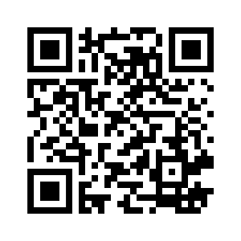
PowerSchools Website
Remind Website

